Slide 1
Corporate Foreign Bond Issuance and Interfirm Loans in China
Yi Huang
The Graduate Institute Geneva & CEPR
Ugo Panizza
The Graduate Institute Geneva & CEPR
Richard Portes
London Business School, CEPR & NBER
Collegio Carlo Alberto, LTI
November 9, 2020

Slide 2
Outline
Motivation and background
Literature
Data
Which firms issue dollar bonds
Use of proceedings
The unintended consequences of prudential regulations
Probing further
Conclusions

Slide 3
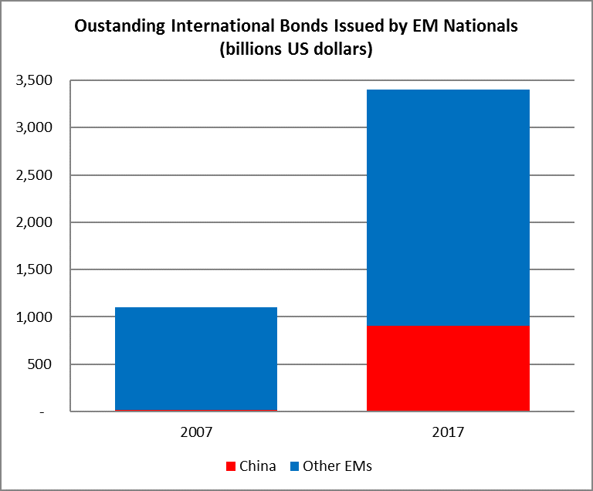
Motivation and background
The aftermath of the Global Financial Crisis was associated with a surge in credit to the non-financial sector and in foreign borrowing by emerging market nationals
China played a key role in these trends
We analyze the drivers of bond issuance and then describe how bond issuers use the proceeds

Slide 4
Motivation and background
China reacted to the global financial crisis with a massive fiscal stimulus.
  In November 2008, the government announced a package worth 4 trillion Yuan (approximately USD 590 billion).
    This policy action tightened the credit conditions faced by private firms (Huang, Pagano, and Panizza, 2020; Shu and Ye, 2018)
This period was also characterized by a set of regulatory reforms that tightened access to credit for firms that belong to economic sectors deemed to be “risky” or characterized by excess capacity
These policies were associated with:
  a rise in the shadow lending rate (Wenzhou rate) faced by Chinese firms, which increased from approximately 13 percent in the winter of 2009-2010 to about 20 percent in mid-2011
  a jump in the issuance of international foreign currency denominated bonds by Chinese non-financial firms.

Slide 5
Official and shadow lending rates
Source: Huang Pagano, and Panizza

Slide 6
Main Findings
Dollar issuance is positively correlated with the differential between domestic and foreign interest rates.
  This effect is particularly important for firms that operate in riskier sectors
Issuers of dollar bonds have lower investment rates and are more likely to lend to other firms
Firms in riskier sectors do more inter-firm lending than firms that operate in other sectors
  Inter-firm lending by firms that operate in riskier sectors and issue dollar bonds increased after a regulatory tightening in 2009-10
Data on entrusted loans confirm that most inter-firm lending is within the same sector and that what really matters is the difference between the RMB lending rate and the USD borrowing rate.

Slide 7
Literature
Foreign currency funding of non-financial firms
  Shin and Zhao (2013), McCauley, McGuire and Sushko (2015), Bruno and Shin (2017), Caballero, Panizza and Powell (2016), Alfaro, Asis, Chari, and Panizza (2016), Frank and Shen (2016), McCauley, Upper and Villar (2013) …
Shadow banking in China
  Du et al. (2016), Chen et al. (2017), Chen et al. (2017), Allen et al. (2017, 2018), Acharya et al. (2016), Hachem and Song (2017), Wang³ and Zhou (2015), Song and Xiong (2018) …
Access to international financial markets
  Didier et al. (2015), Gozzi et al. (2010), Gozzi et al. (2015), ...

Slide 8
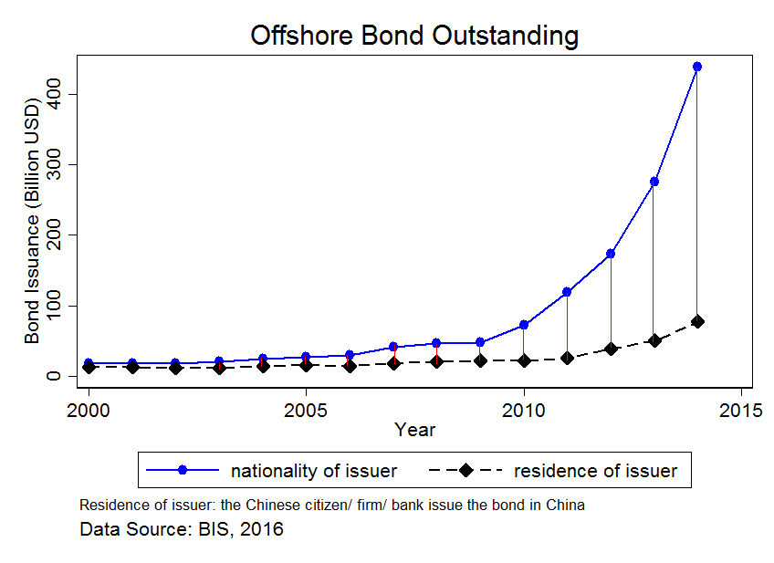
Data
We merge bond-level data from Dealogic with firm-level data from China Stock Market and Accounting Research (CSMAR)
We also merge these data with a hand-collected dataset on entrusted loans.
  We collect information on all bonds issued by Chinese nationals over the period 2005-15. The focus on nationals rather than residents is important because over 2009-15 there was a massive increase in international bond issuance by non-resident Chinese

Slide 9
Bond-level Data
Our bond-level data from Dealogic contain 25,032 observations and include domestic and international issuances in all currencies by all types of issuers
  We exclude from our dataset all bonds issued by financial institutions and the central government (8,394 bonds) and all bonds issued by non-listed corporations (12,008 bonds). We also drop from the sample a small number of bonds (176 in total) which are issued in currencies different from the US dollar or the RMB
  We are left with 4,958 bonds from 1,353 issuers. About 87 percent of these bonds are denominated in RMB and the remaining 13 percent (645 bonds and 238 issuers) are denominated in US dollars.

Slide 10
Merging
We start with a total of nearly 60,000 firm-level observations from CSMAR and after restricting our sample to listed non-financial and non-government sectors with complete data on revenues and inter-firm loans, we are left with 24,596 observations covering 3,177 firms over 2005-15
We match the bond-level and the firm-level data.
  We are able to recover information for most bond issuers, but there are 486 bonds (of which 78 are dollar-denominated bonds) for which we cannot find issuer data.
Our final sample consists of 4,472 bonds (567 of these bonds are denominated in US dollars).
  About one-third of the firms in our sample have issued at least one bond, and 6 percent of the firms in our sample have issued dollar-denominated bonds.

Slide 11
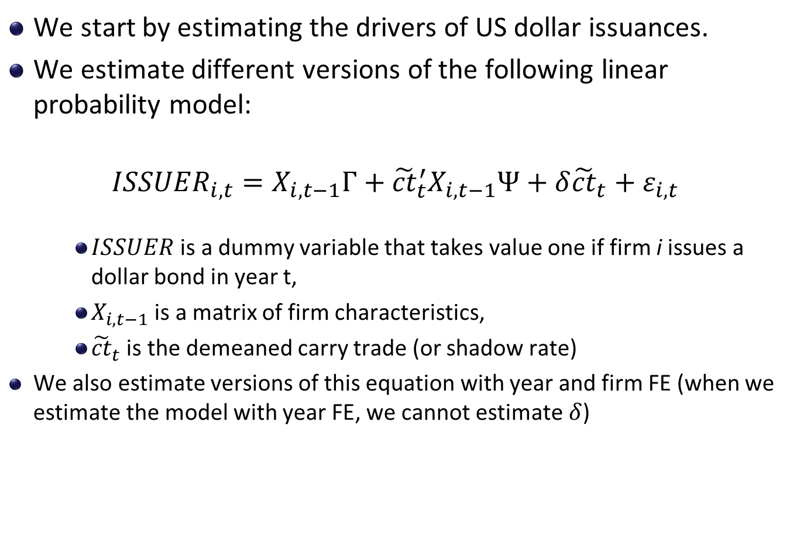
The drivers of US dollar bond issuance
We start by estimating the drivers of US dollar issuances.
We estimate different versions of the following linear probability model:
$${ISSUER}_{i,t}=X_{i,t−1}Γ+{\tilde{ct}}_{t}^{′}X_{i,t−1}Ψ+δ{\tilde{ct}}_{t}+ε_{i,t}$$
    $ISSUER$ is a dummy variable that takes value one if firm i issues a dollar bond in year t,
    $X_{i,t−1}$ is a matrix of firm characteristics,
    ${\tilde{ct}}_{t}$ is the demeaned carry trade (or shadow rate)
We also estimate versions of this equation with year and firm FE (when we estimate the model with year FE, we cannot estimate $δ$)

Slide 12
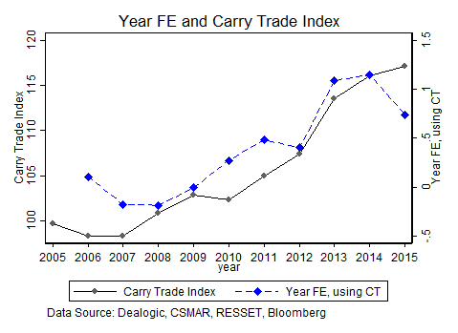
The drivers of US dollar bond issuance

Slide 13
Financial vs non-financial Intermediaries
Theory suggests that Banks borrow to lend (positive correlation between debt and financial assets) and NFI borrow to invest (positive correlation between debt and fixed investment)
Bruno and Shin (2017) and Shin and Zhao (2013) find that this is the case in AEs. However, in EMs, they often find that NFIs behave like banks: They borrow to lend
We focus on China

Slide 14
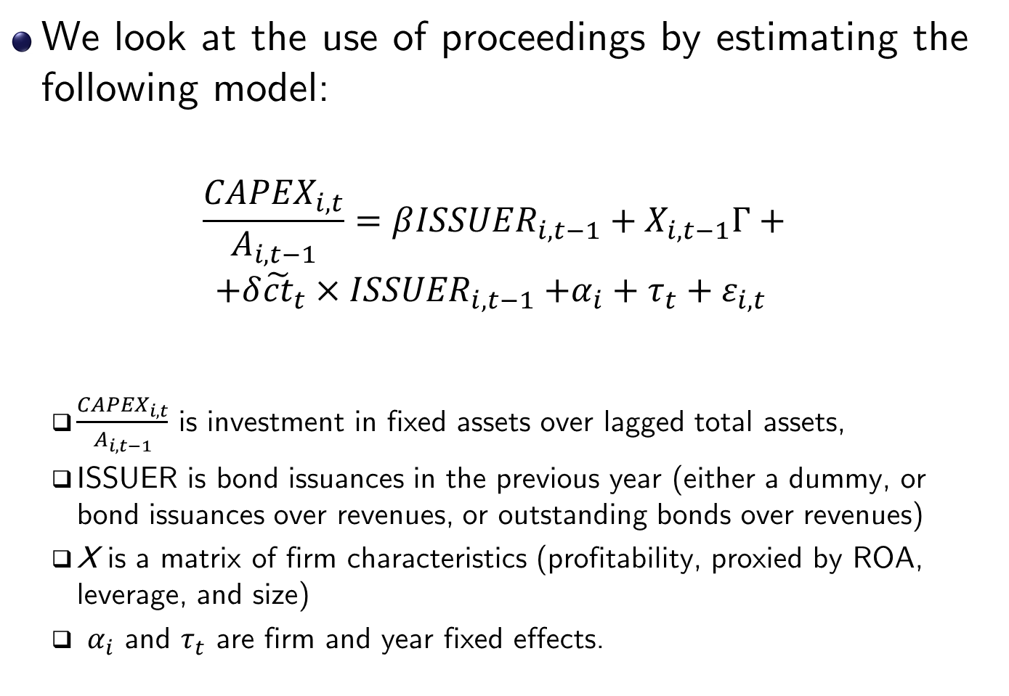
Inv. in fixed assets and dollar bond issuances
We look at the use of proceedings by estimating the following model:
$$\frac{{CAPEX}_{i,t}}{A_{i,t−1}}=β{ISSUER}_{i,t−1}+X_{i,t−1}Γ+$$
$$+δ{\tilde{ct}}_{t}{×ISSUER}_{i,t−1}+α_{i}+τ_{t}+ε_{i,t}$$
  $\frac{{CAPEX}_{i,t}}{A_{i,t−1}}$ is investment in fixed assets over lagged total assets,
  ISSUER is bond issuances in the previous year (either a dummy, or bond issuances over revenues, or outstanding bonds over revenues)
  X is a matrix of firm characteristics (profitability, proxied by ROA, leverage, and size)
  $α_{i}$ and $τ_{t}$ are firm and year fixed effects.

Slide 15
Inv. in fixed assets and dollar bond issuances

Slide 16
Cash holdings and dollar bond issuances

Slide 17
Cash holdings and dollar bond issuances
Puzzling??
But remember this….
Borrowing in USD and putting the money in a local currency bank account can yield carry trade returns in Brazil, but not necessarily in China

Slide 18
Inter-firm loans and dollar bond issuances
Results become stronger if we exclude state-owned firms

Slide 19
Inter-firm loans and dollar bond issuances
Controlling for RMB issuances

Slide 20
Inter-firm loans and dollar bond issuances
Intensive versus extensive margin

Slide 21
Inter-firm loans and dollar bond issuances
Heterogeneity

Slide 22
So far…
Risky firms issue more dollar bonds, especially when carry trade returns are high
Firms that issue more dollar bonds, do not invest more
Firms that issue more dollar bonds lend more to other firms, especially when carry trade returns are high, especially when they operate in risky sector

Slide 23
The unintended effects of prudential regulation
Guiding Opinions on Further Strengthening Financial Services With a View to Supporting the Adjustment and Rejuvenation of Some Key Industries and Restraining Excess Capacity in Other Industries
  Issued on December 22, 2009, by the People’s Bank of China, the China Banking Regulatory Commission, the China Securities Regulatory Commission, and the China Insurance Regulatory Commission
  It stated that “in order to serve the overall objective of supporting economic growth and restructuring the economy,” the People’s Bank of China will “enhance surveillance on credit structure,” and “effectively contain overcapacity.”
  This policy tightened access to domestic credit (bank loans and issuance of securities) for firms that operate in economic sectors that are deemed to be risky
Notice on Financial Services to Further Support Energy Saving and Eliminate the Backward-Production Capacity
  Issued on May 28, 2010, by the People’s Bank of China and the China Banking Regulatory Commission
  It further restrained access to credit for firms that operate in sectors deemed to be risky.

Slide 24
The unintended effects of prudential regulation
In a classic case of regulatory arbitrage, there is evidence that these policies contributed to the rapid growth of the Chinese shadow banking system.
  Chen, Ren, and Zha (2017) show that the share of entrusted loans (a typical shadow banking instrument in China) in total bank lending tripled during the tightening period, and more than 60 percent of these entrusted loans were channeled to firms that operate in risky sectors.
We study a different type of regulatory arbitrage
  We use the policy shock of 2009-10 to test whether the regulatory reforms increased the likelihood that risky firms issue dollar bonds and then use the proceeds to onlend to domestic firms in similar sectors.

Slide 25
Inter-firm loans as regulatory arbitrage

Slide 26
Inter-firm loans as regulatory arbitrage

Slide 27
Inter-firm loans as regulatory arbitrage
Excluded group:
Non-issuer, non-risky, no policy
Without FE
***
***

Slide 28
Our hypothesis:
  Firms that operate in risky sectors have a comparative advantage (linked to information) in lending to firms that operate in risky sectors
  This is why lending by inter-firms loans that operate in risky sector and that are not constrained by regulation (because they can borrow aboard) start lending more to credit constrained firms
We now check if this hypothesis is supported by data on entrusted loans

Slide 29
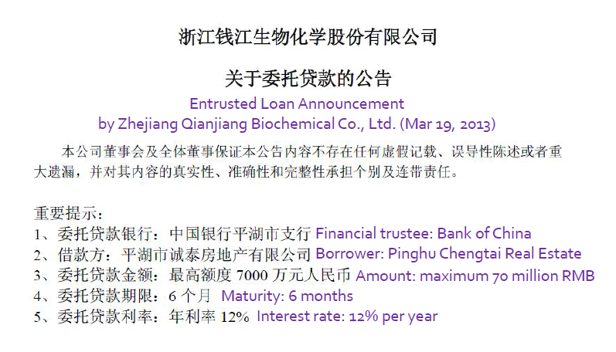
Probing further: Entrusted loans

Slide 30
Entrusted loan data
2,655 entrusted loans over 2007-15: 467 creditors and 1,074 debtors (only 100 obs before 2010)
One of our key assumption is that bond issuers in a given industry are more likely to lend to firms in the same industry
We can check if this is true with our entrusted loans data by comparing their actual allocation with a random match

Slide 31
Entrusted loan data

Slide 32
Entrusted loan characteristics
Note that for “Same industry” we lose observations because we only have the code for 1,348 borrowers (we have the code for all lenders)

Slide 33
Entrusted loan characteristics

Slide 34
Using entrusted loan data to compute CT returns
Dependent Variable: Interfirm Loans
SP$= average interest rates on entrusted loans minus average interest rate on USD bonds
CNY$= average interest rates on entrusted loans minus average interest rate on RMB bonds
Note: these are averages for the year, not firm-level values

Slide 35
Conclusions and Policy Implications
Our findings are not in line with the hypothesis that firms choose their liability structure to jointly minimize funding costs and currency risk
They are instead consistent with the hypothesis that firms that operate in riskier sectors try to boost profitability by engaging in activities that mimic the behavior of financial institutions
We also look at regulatory arbitrage and find that regulation aimed at limiting domestic leverage in risky sectors may have created incentives for moving to even riskier sectors

Slide 36
Corporate Foreign Bond Issuance and Interfirm Loans in China
Yi Huang
The Graduate Institute Geneva & CEPR
Ugo Panizza
The Graduate Institute Geneva & CEPR
Richard Portes
London Business School, CEPR & NBER
Collegio Carlo Alberto, LTI
November 9, 2020

