Slide 1
Collegio Carlo Alberto
Torino
Venerdì 16 dicembre
The “invisible hand”
Fiscal welfare's policies, politics, outcomes
& implications for the Italian model of social protection

Slide 2
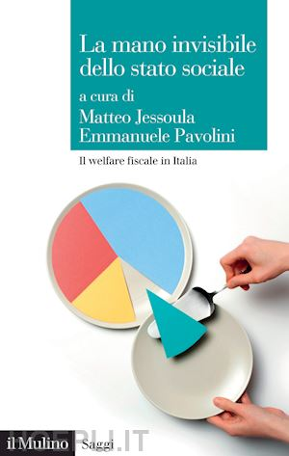

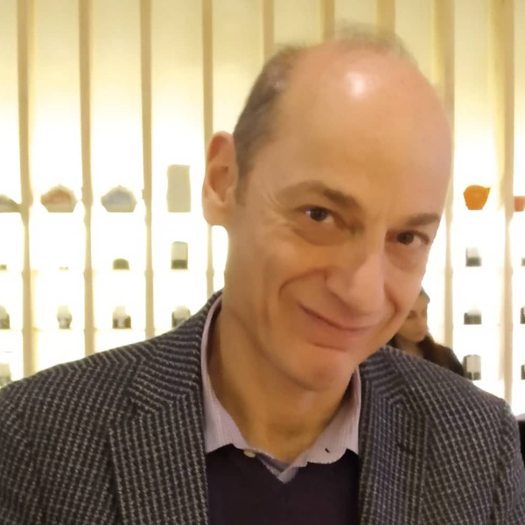


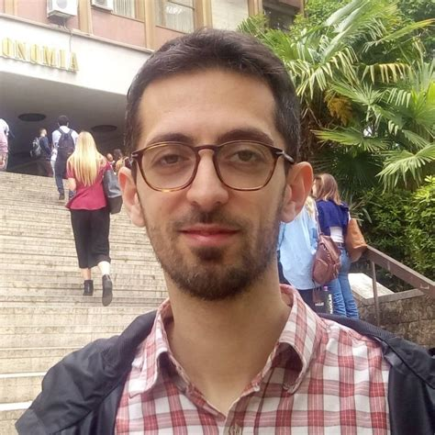




The “invisible hand”
«Una esenzione, in questo nostro beato paese, […] non si rifiuta a nessuno»
Ezio Vanoni [1949]
2

Slide 3
The “invisible hand”
Fiscal Welfare: back to Titmuss…& Castles
Boundaries & context: Fiscal Welfare as a “plastic” policy tool
Key figures
Fiscal Welfare & Tax System
..& Social Welfare
..& Occupational Welfare
The Politics of Fiscal Welfare
Conclusions
3

Slide 4
The “invisible hand”
Fiscal welfare: back to Titmuss …& Castles
3 different redistributive channels for the provision of welfare benefits
Social welfare
public welfare benefits and services
Occupational welfare
social benefits established by collective agreements / provided unilaterally by employers
Fiscal welfare
measures aimed at facilitating access to welfare provisions through the tax system…
“hidden welfare state”… (Hacker 2002) or pursuing socially relevant goals by “other means than social policies” (Castles 1985)
4

Slide 5
The “invisible hand”
Boundaries & context:
Fiscal Welfare as a “plastic” policy tool
Fiscal
welfare
Social protection
Tax system
Economy
Social Welfare
Occupat. welfare
Privat welfare
Industr relat.
Product.
Finance
5

Slide 6
The “invisible hand”
Key figures
In 2018-20 Fiscal Welfare “tax expenditures” amounted to ca. 70 billion Euros/year vs 505 billion Euros of total state revenues
Main sectors: housing 29%, labour 23%, family/children 20%; income support 18%, health/disability 7%, pensions 3%
Thus, in 2018 this amount corresponded to:
14% of total tax revenues
15% of total social protection expenditure (from 9% in 2009)
In 2009-18
fiscal welfare costs increased by 30 billion/Euros
+74%….despite austerity….
…vs +16 billion Euros in Social welfare
6

Slide 7
The “invisible hand”
Fiscal welfare & Tax system:
From broad redistributive plans to piecemeal measures
Mid-1960s / Early-1990s
Fiscal welfare supports the modernization of the Italian tax system within a major redistributive plan, relying on the with the introduction of IRPEF (’74)
Tax advantages aimed at ensuring horizontal equity between households with similar income but different needs (tax deductions for family members) or improving access to relevant services (meals excluded from workers’ income)
Since the mid-1990s
“Cruising with no route” (Bosi e Guerra 2020): gradually lost overall objectives of the plan in tax policy ..& fiscal welfare as well
“Americanization” à la Steinmo (1989): enlarging plethora of tax deductions/advantages/incentives/ aimed to capture micro-corporatist socioeconomic demands and pressures de facto reduction of progressivity
7

Slide 8
The “invisible hand”
Services, cash transfers &
fiscal welfare
% of total social & fiscal welfare expenditure, 2009-18
8

Slide 9
The “invisible hand”
Fiscal & Social welfare a changing balance in expenditures
Ratio between fiscal and social welfare expenditure, 2009-18
9

Slide 10
The “invisible hand”
Fiscal & Occupational welfare:
happy marriage … or perverse relationship?
Happy marriage
Occupational and company-based welfare likely to be very residual in Italy without tax incentives
…& perverse relationship
Budget Law 2016 and 2017
the effects of tax exempted productivity bonus
… the perverse effects in healthcare and especially pensions
10

Slide 11

The “invisible hand”
The distributional dimension of Fiscal-Occupational welfare
6 key cleavages & challenges
The outsiders…
Voluntarism
vs compulsion
Economic structure
(productive sectors, firm size..)
Labour market segmentation
(employment sector, position..)
Territorial
divides
Flexible labour markets
11

Slide 12
The “invisible hand”
Fiscal (& Social) welfare
distributive impact by income deciles
12

Slide 13
The “invisible hand”
Welfare & tax policies
The long term trajectory
 | Fiscal welfare | Social welfare | Tax policies
1965-1991 | Redistributive | Distributive | Redistributive
1992-1995 | Regulatory | Retrenchment (Regulatory) | Redistributive
1996-2009 | Distributive and micro-distributive | Retrenchment (Regulatory) | Distributive
2010-2013 | Micro-distributive | Retrenchment | Micro-distributive
2014-2020 | Micro-distributive | Micro-Distributive | Micro-distributive
13

Slide 14
The “invisible hand”
Policy & Politics
 | Social welfare | Fiscal welfare
Expenditure | Typically high Very visible | Generally low Non-transparent
Salience | Very High | Low
Arenas | Ministry Labor/Welfare Parliament | Ministry Economy/Finance
Policymaking Union involvement | Neocorporatist Medium-high | Pluralist Medium-low
Citizens involvement | Medium-high | Low
Density of veto actors | High | Low
14

Slide 15
The “invisible hand”
The Politics of fiscal welfare policies
Policy
Public resources extensively used to address the New Social Risk, relying on outsourcing/freedom of choice, & support private welfare programs
Politics
Opacity of rules, effects & policymaking processes
Decisional arenas different from social welfare
“Quiet politics” à la Culpepper
Over-representation of Capital (employers, financial actors)
Unlikely “Veto” by Labour (trade unions)
In a context characterized by institutional resilience & constraints on available resources
FW works as catalyzer of political support
via micro-distributive “political exchanges” aimed to “capture” social and private clienteles
15

Slide 16
The “invisible hand”
Conclusions
Distributional effects differ across sectors, but …
Overall regressive distributional effects: most well-off households receive 5 times more resources (15%) than the least well-off (3%)
Regressive effects worsened by non-consideration of individuals who do not pay taxes (incapienza): ca. 4 billion Euros of non-paid benefits for most disadvantaged individuals
16

Slide 17
The “invisible hand”
Conclusions
Context marked by high institutional resilience, constrained economic resources and strict monitoring of public expenditure
Opacity of fiscal welfare costs & decision making processes make it a formidable tool for “hidden” public/social expenditure
…& a key instrument to catalyze immediate political support among key social and private clienteles through “political exchanges” relying on micro-distributive measures
Characterized by a “quiet politics” which allows overcoming the traditional “veto points” in social policy arenas
17

Slide 18

The “invisible hand”….
be aware…
Thanks for joining!

Slide 19
The “invisible hand”
Conclusions
Un welfare fiscale più limitato (meglio pochi strumenti con molti beneficiari rispetto ad un pletora di agevolazioni settoriali con pochi beneficiari), e meno regressivo (facendo ricorso a detrazioni indipendenti dalla capienza fiscale) permetterebbe il riorientamento delle risorse dei contribuenti verso strumenti più equi e più trasparenti necessari per integrare il welfare di tipo fiscale e sociale, evitando interazioni distorsive e contradditorie e semplificando il sistema nel suo complesso.
19

Slide 20
The “invisible hand”
The perverse relationship:
tax exempted productivity bonus
2016-2020 54.600 company-based collective agreements
INAPP Study on 30.000 contracts:
ca. 11 billion Euros tax exempted
beneficiaries: 7 million employees in private sector
77% of contracts in Northern Italy
ca. 50% in firms with at least 50 employees
Share of firms that applied
20

Slide 21
The “invisible hand”
The perverse relationship:
tax exempted “productivity bonus”
Survey results
2.314 medium-large firms (50+ employees), stratified sample
50% bonus 100-499 euros; 40% bonus 500+ euros
28% applied for tax exemption
16% planning to apply
30% tax exemption used to provide welfare benefits
2 “strategic approaches”
a. organizational: aimed to achieve productivity gains via increased workers’ welfare (enabling)
b. opportunistic: aimed to reduce labor cost (capture)
21

Slide 22
The “invisible hand”
Public & Supplementary Occupational Pensions:
a perverse encounter
Duplication of strictly actuarial social insurance principle in the 3 pillars
Large coverage gaps in supplementary pillars
ca. 15 million workers out of 23 million
Coverage gaps reflect structural cleavages
sector, firm-size, territory, contract/lab.mkt position
Extremely limited vertical redistribution
Detrimental for disadvantaged workers
Risk of pension income polarization next
Limited equity, effectiveness, efficiency in usage of public resources
22

Slide 23
The “invisible hand”
Supplementary funded pensions
Coverage
Total employment
ca. 23 million
5,1 mil. private employees;
1,9 mil. Self employed;
180.000 Public employees
Members of supplementary schemes 7,2 million
Active members
5,4
milion
23

Slide 24
The “invisible hand”
Occupational 2nd pillar closed funds
Fragmentation
75%
40%
10%
metal
chemical
Small
Take up rates in 2007 2015
24
Elaborazione su dati Covip

Slide 25
The “invisible hand”
Occupational 2nd pillar closed funds
Fragmentation
Commerce
10%
Construction
Energy
25
Take up rates in 2007 2015
Author’s elaboration on Covip data

Slide 26
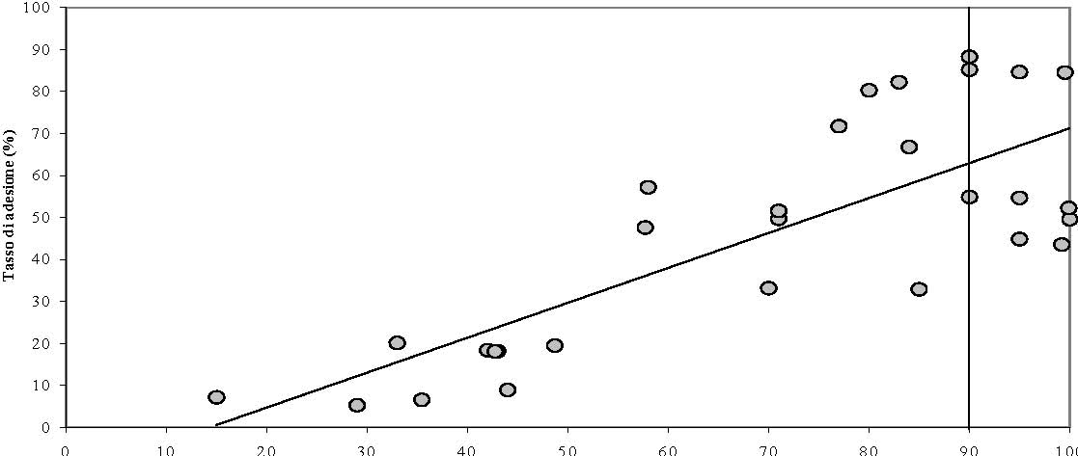
The “invisible hand”
The constraints of the economic structure
Small Firms & supplementary pension coverage
Take up rate %
Share of potential pension fund members employed in firms with at least 50 employees (%)
26

Slide 27
The “invisible hand”
Dysfunctional effects
& risk of pension income polarization
Over-financing & Overprotection
  “Standard” workers in medium/large size firms
  Contribution rate: 43% = 33% + 9.5% (1st pillar + 2nd pillar)
  NET Total RR: 106% = 78% + 28% (1st + 2nd pillar)
Risk of Inadequate protection & regressive factors
  Workers with “atypical” fragmented careers
  Contribution rate: 33 % (1st pillar)
  1st pillar, lower Replacement rate: ca. 55% net / 30y. seniority
  2nd pillar, no/very limited coverage !!
COVERAGE
By
AGE
16% < 35 years
24% 35-44 years
31% 45-64 years
27
27

Slide 28
The “invisible hand”
The distributional dimension of Fiscal-Occupational welfare
6 key cleavages & challenges
The outsiders…
Voluntarism
vs compulsion
Economic structure
(productive sectors, firm size..)
Labour market segmentation
(employment sector, position..)
Territorial
divides
Flexible labour markets
28

